Slide 1
Taraba Verde
(Green Stand)
In a world where we are inundated with products grown with chemical fertilizers and devoid of natural essence, people are increasingly seeking truly healthy products!

Slide 2
We at Taraba Verde (Green Stand) sell health!
The difference we bring to the market is that we prove to customers that our products are truly natural, through laboratory tests conducted and periodic checks of both producers and plantations.
We support small-scale producers.
We are developing the local economy and providing an opportunity for the growth of small local producers.
Proven quality.
We carefully select producers within the Green Stand network and conduct checks throughout the year.

Slide 3
All-natural, in one place.
Vegetables and fruits
Products both fresh and preserved in jars, jams, pickles, preserves, etc.
Meat and meat derivatives
The entire range of products refers to smoked meat, not fresh or frozen, only smoked.
Juices and other beverages
Cold-pressed fruit juices or other fruit beverages such as berry fruit wine, etc.

Slide 4
What are we aiming for?
Creating a brand where customers know they will find only verified natural products, online or in one of the physical stores nationwide!
The possibility of renting a small plot of land, where the customer can choose what they want to plant and can visit anytime with their family!
Creating a network of restaurants where it's specified on the menu that they use ingredients from Green Stand!

Slide 5
How do we want to develop the company?
The analysis we have conducted has shown that we need 5 stores, one in each major city, to expand our product delivery network across Romania. This way, we will achieve sales both directly in-store and through home delivery with the help of delivery companies. This translates to an estimated turnover ranging from 400,000 euros to 800,000 euros with an additional investment of 300,000 euros.
5+
300.000+
400.000+
Grocery store
Investment
Turnover

Slide 6
Every $1000 generates $380 profit.
Due to the very high demand from customers and the fact that it's a unique concept, it allowed me to test the market with just a $1000 initial investment. I made a profit of $380, which I reinvested. I am aware of the immense potential of this business model and attempted to borrow money from the bank, but I couldn't secure the loan with real estate. In the end, I managed to obtain only $20,000, but I did not accept it.

Slide 7
The company utilizes both in-store sales and online sales. This sales approach ensures financial stability and a larger customer base.

Slide 8
Natural means it doesn't have chemical fertilizers, chemical compounds, or chemical treatments. Everything we currently see in stores doesn't meet these characteristics to be considered natural. I've obtained natural products at the same price as non-natural ones. Amazing, isn't it?
I hope you understand what I mean when I say natural.

Slide 9
I have everything prepared: producers all over Romania, a project for each physical store, a functional online store, delivery company, advertisements, but something is missing... THE MONEY.

Slide 10
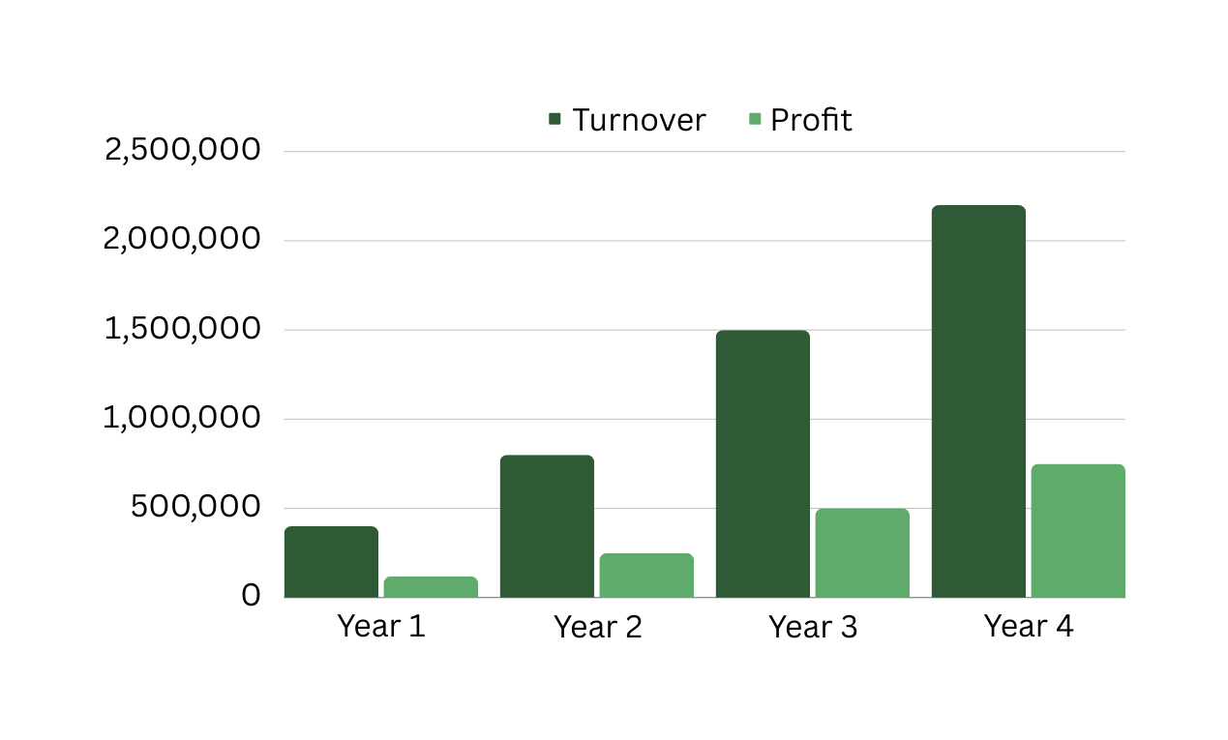
Forecast according to estimations.
If the strategy I initiated is followed, along with an investment of 300,000 euros, this is how the results should look in the next years, guaranteed.

Slide 11
Thank you very much!
Our website
Email address
Phone number
www.tarabaverde.ro
officetarabaverde@gmail.com
0721001190

